Slide 1
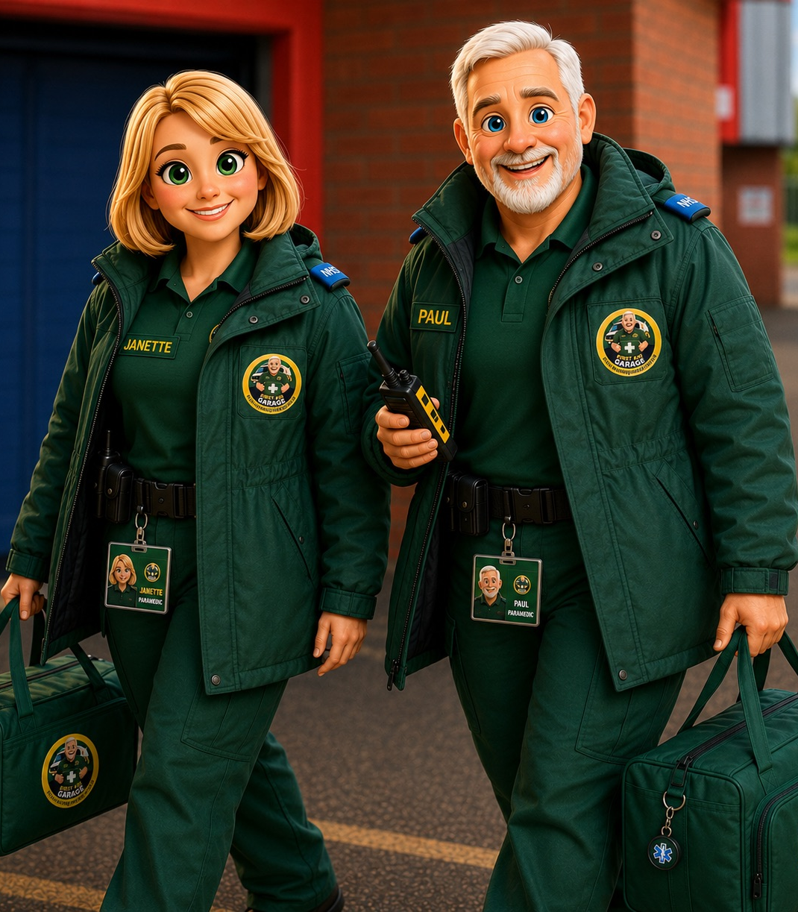

STAFF AWARENESS • EARLY YEARS
Breath-holding
spells in nursery
Recognise the pattern
Protect the child
Escalate safely
Evidence-based awareness for nursery teams in England
www.firstaidgarage.co.uk

Slide 2
FIRST AID GARAGE
Know the usual pattern
Breath-holding is involuntary and is often triggered by strong emotion, sudden pain or shock.
BEFORE
DURING
AFTER
The child may cry, become upset or react to a bump or fright.
They may become silent, turn pale, blue or grey, go floppy or stiff, jerk or briefly faint.
They may be sleepy or confused for a short time and need reassurance and rest.
Staff observe and respond — they do not diagnose.
www.firstaidgarage.co.uk
Source: NHS — Breath-holding in babies and children
2

Slide 3
FIRST AID GARAGE
Prepare before the next episode
01 CONFIRM
A written plan makes the response clear before an emergency.
Known diagnosis and any individual clinical advice.
02 DESCRIBE
Triggers, colour, movements, duration, recovery and usual baseline.
Ask whether a GP or healthcare professional has assessed the episodes.
03 AGREE
Staff actions, 999 criteria, parent contact and collection arrangements.
04 BRIEF & REVIEW
Share with relevant staff and update when the pattern or advice changes.
www.firstaidgarage.co.uk
Sources: NHS; EYFS and DfE first-aid guidance
3

Slide 4
FIRST AID GARAGE
During a typical spell: protect and observe
01
STAY CALM & TIME IT
Note when the episode begins.
02
LIE THE CHILD ON THEIR SIDE
Do not pick them up.
03
PROTECT FROM INJURY
Clear nearby objects; protect the head and limbs.
04
STAY & OBSERVE
Watch breathing, responsiveness and recovery.
Never punish the child — the episode is not deliberate.
www.firstaidgarage.co.uk
Source: NHS — Breath-holding in babies and children
4

Slide 5
FIRST AID GARAGE
Keep the mouth clear
NO DUMMY DURING AN ACTIVE SPELL
The NHS advises that nothing should be placed in the child’s mouth during an episode.
DO
DO NOT
Keep the airway clear
Position the child safely on their side
Stay with them and monitor
Insert a dummy, fingers or any object
Shake the child or splash water
Restrain or tell the child off
A dummy may only be considered before the spell or after full recovery, if consistent with the setting’s policy and the child’s plan.
www.firstaidgarage.co.uk
Source: NHS — ‘Do not put anything in their mouth’
5

Slide 6
FIRST AID GARAGE
Call 999 when it could be more serious
CALL 999 IMMEDIATELY
CANNOT BE WOKEN
STIFF / SHAKING / JERKING
PALE, BLUE OR GREY
The child faints and does not respond normally.
This may be a fit and needs urgent assessment.
Sudden colour change may have another serious cause.
UNRESPONSIVE + NOT BREATHING NORMALLY
Call 999 and begin paediatric basic life support/CPR in line with training and call-handler instructions.
www.firstaidgarage.co.uk
Sources: NHS breath-holding and child resuscitation guidance
6

Slide 7
FIRST AID GARAGE
Recovery is part of the response
REASSURE
REST & REASSESS
RECORD
INFORM
Respond calmly. Do not punish or reward an involuntary event.
Document the trigger, timing, appearance, first aid and recovery.
Tell the parent or carer and follow reporting duties where applicable.
Observe until the child has returned to normal responsiveness and behaviour.
SHOULD THE CHILD GO HOME?
Collection is appropriate if the episode was severe or unusual, the child has not returned to baseline, further close observation is needed, or the setting cannot safely meet the child’s needs. Follow clinical advice, the written plan and setting policy.
www.firstaidgarage.co.uk
Sources: NHS; DfE first-aid recording and reporting guidance
7

Slide 8
FIRST AID GARAGE
Make the child-specific plan usable
THE WRITTEN PLAN
THE TEAM
• Known diagnosis or clinical advice
• Triggers and usual presentation
• Expected duration and recovery
• Immediate staff actions
• 999 escalation criteria
• Parent contact and collection
• Review date and responsible lead
Relevant staff are briefed
A paediatric first aider is available
Roles are clear during an emergency
Every episode is recorded and reviewed
If the pattern changes, pause and seek updated medical advice.
www.firstaidgarage.co.uk
Source: EYFS statutory framework and DfE first-aid guidance
8

Slide 9
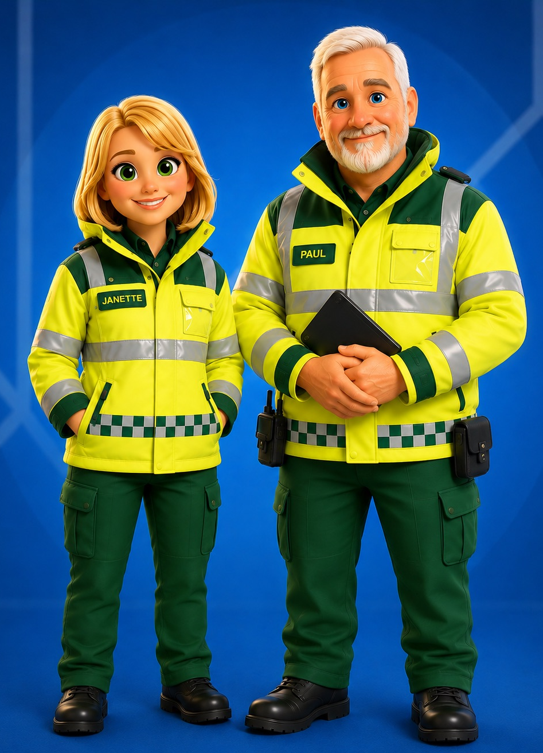
THE THREE RULES
Recognise.
Protect.
Escalate.
Keep the child on their side. Keep the mouth clear. Call 999 when emergency criteria are met — and start basic life support if unresponsive and not breathing normally.
NHS • EYFS • DfE first-aid guidance
Staff awareness only — follow paediatric first-aid training and child-specific clinical advice.

